Slide 1
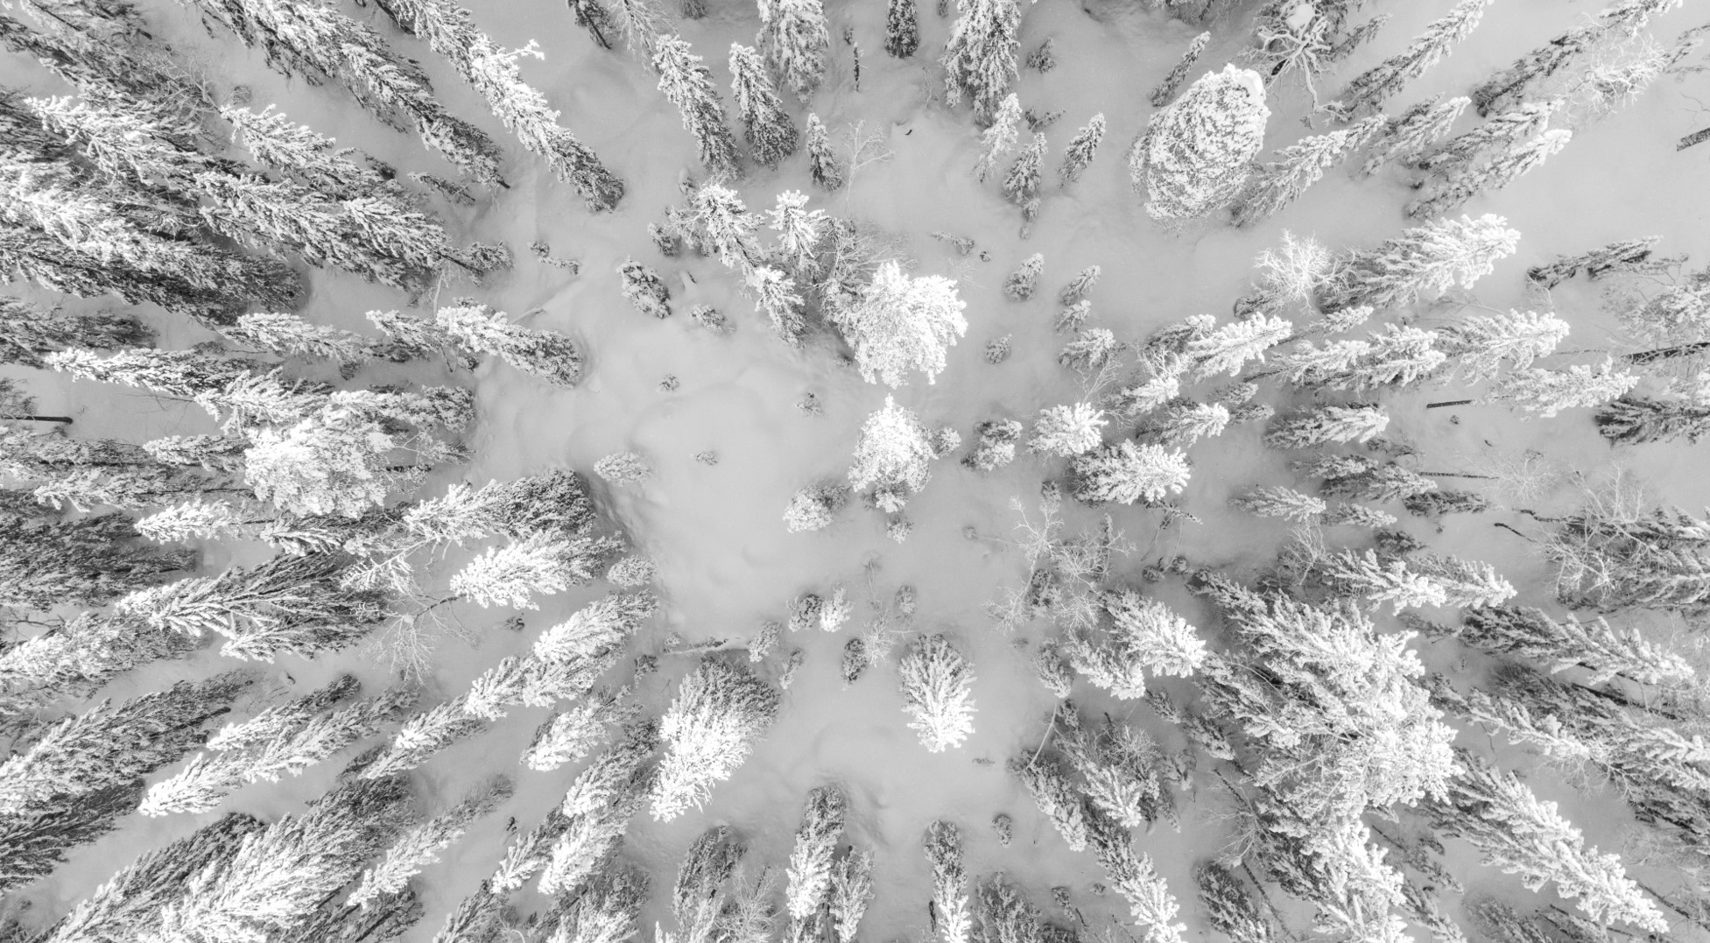
Big Mountain Ski Resort
Montana, US

Slide 2
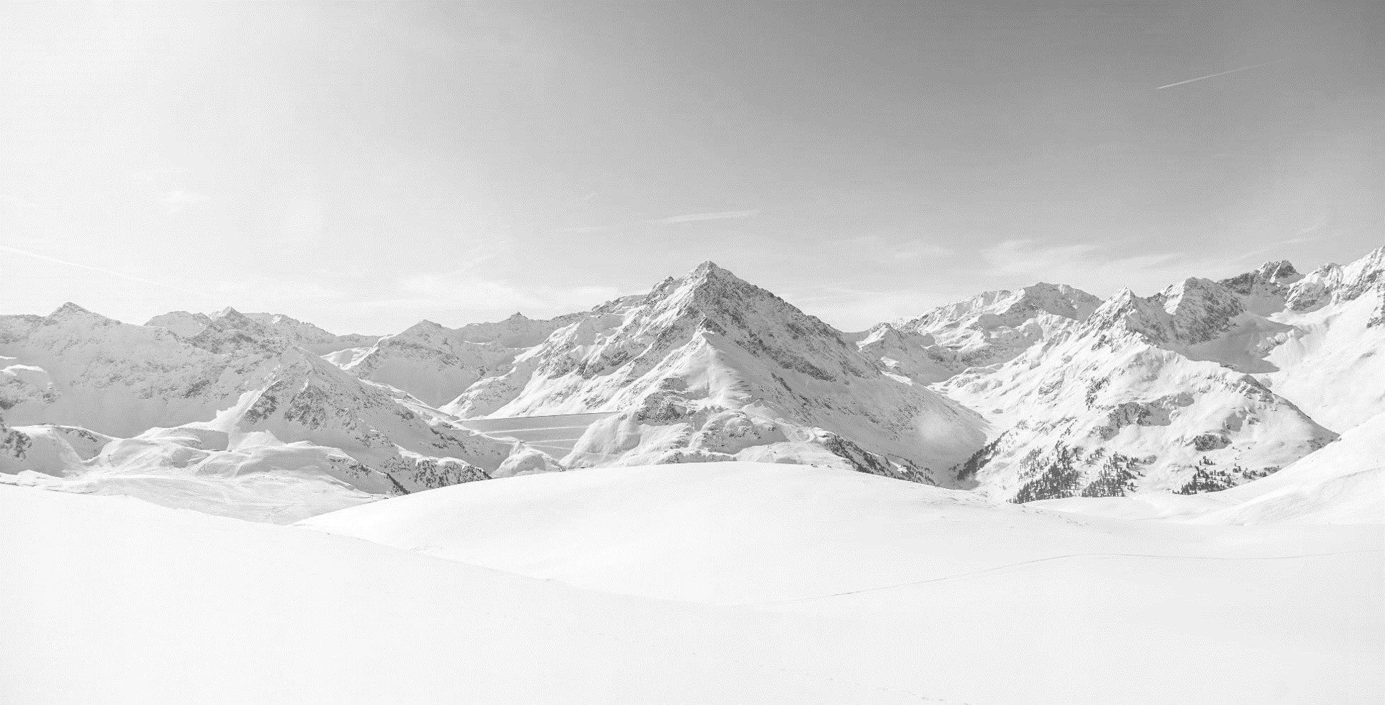
Problem identification

Slide 3
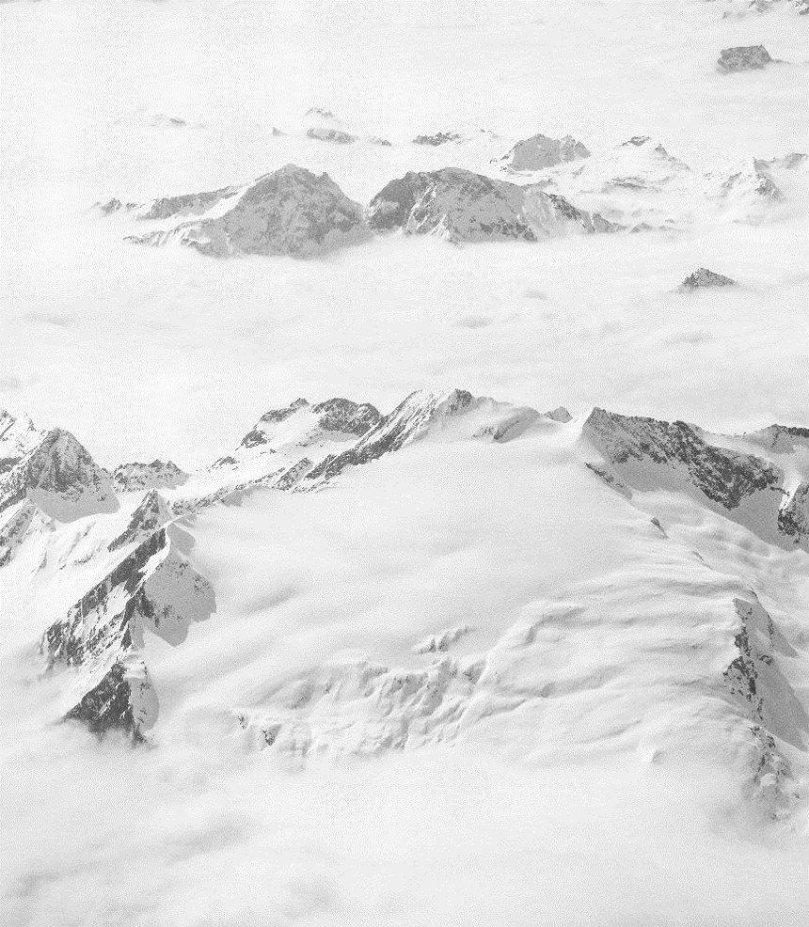
To improve the profitability of the Big Mountain Resort by increasing the ticket price and/or cutting costs to cover the operating cost of $1,540,000 by this season.
What is the suggested ticket price?
Possible cutting cost areas:
Permanently closing down up to 10 of the least used runs.
Increase the vertical drop by adding a run to a point 150 feet lower down but requiring the installation of an additional chair lift to bring skiers back up, without additional snow making coverage
Same as number 2, but adding 2 acres of snow making cover
Increase the longest run by 0.2 mile to boast 3.5 miles length, requiring an additional snow making coverage of 4 acres

Slide 4
Recommendation and key findings

Slide 5
Recommendation
Permanently closing down up to 10 of the least used runs.
Closing 1 run, makes no difference
Closing 2 and 3 successively reduces support for ticket price and so revenue.
Closing 3, 4 or 5, will give you the same reduction on ticket price.
Closing 6 or more runs, will give you a higher ticket price reduction.
Increase the vertical drop by adding a run to a point 150 feet lower down but requiring the installation of an additional chair lift to bring skiers back up, without additional snow making coverage. Makes no difference in ticket price.
Same as number 2, but adding 2 acres of snow making cover. Makes no difference in ticket price.
Increase the longest run by 0.2 mile to boast 3.5 miles length, requiring an additional snow making coverage of 4 acres. Makes no difference in ticket price.
To increase the weekend ticket price from $81 to $95.87 (+/- $10.39 of margin)

Slide 6
Modeling results and analysis

Slide 7
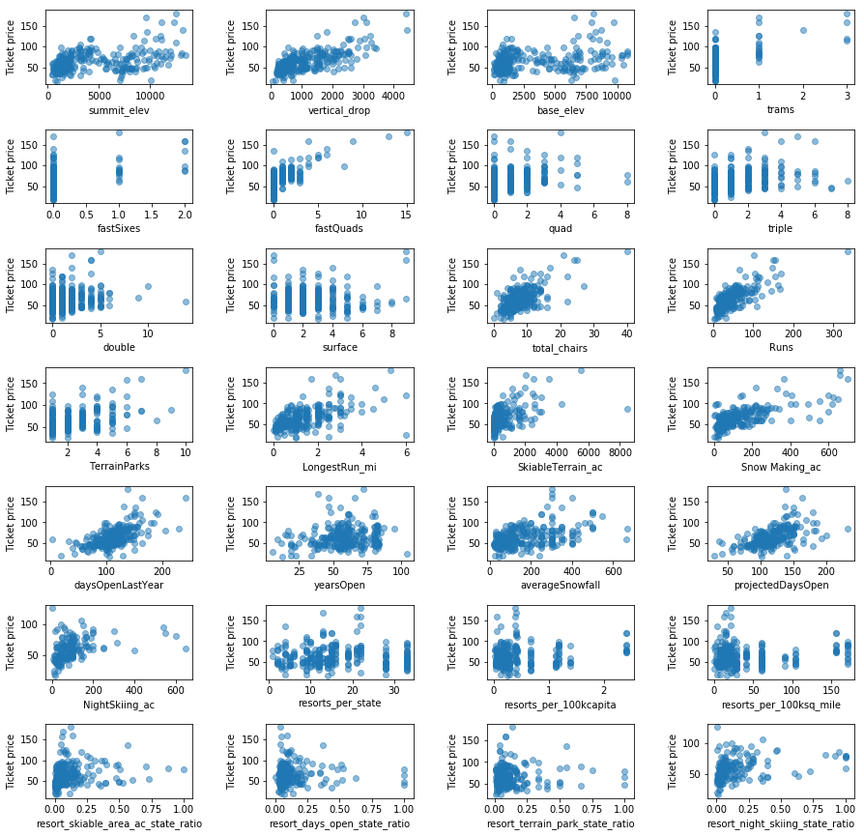
Modeling results and analysis
The diagrams in the left show the amount of correlation the features below have regarding the price.
Vertical drop
fastQuads
Runs
Total_chairs
Resorts_per_100kcapita
Snow Making_ac
LongestRun_mi
Trams
SkiableTerrain_ac

Slide 8
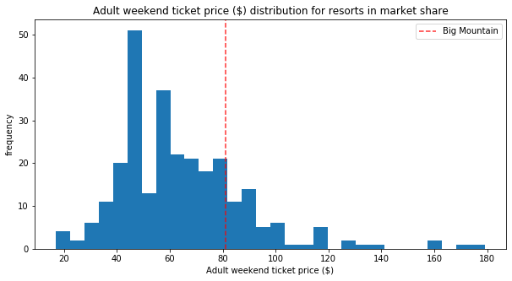
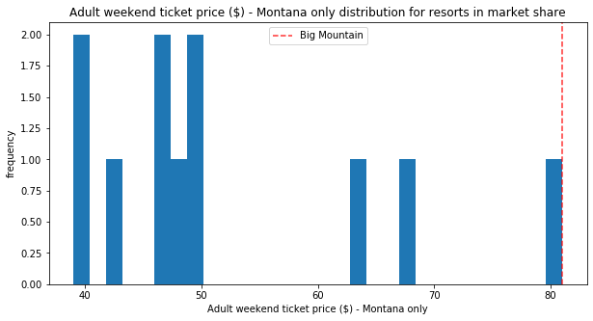
Continuing… Modeling results and analysis
After applying the ML model to the features with higher correlation, we predict that the price could be $95.87. This will place the resort in a good position considering:
The whole market
Other resorts in Montana

Slide 9
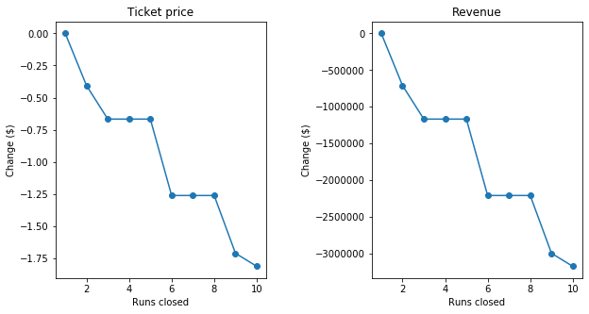
Continuing… Modeling results and analysis
Regarding permanently closing down up to 10 of the least used runs, there are a couple options that will affect the ticket price and the revenue.

Slide 10
Summary and conclusion

Slide 11
Summary and conclusion
The suggested price is $95.87, which fulfill the initial need to cover for the new operational cost of $1,540,000 for this season. The closing of the runs can be left for future plans.
Final calculations
Conclusion
New revenue from tickets: $95.87 - $81 = $14.87
We are expected 350,000 visitors this season
And in average, each visitor stays for 5 days, which equals 5 tickets.
With this price change, the new operational cost will be covered and the mountain will still make a revenue of $22,732,500
14.87 x 5 x 350000 – 1540000

Slide 12


Thank You
Miguel Barriga

